Slide 1

Tracking the Weaponisation and Manipulation of Cultural Heritage in Ukraine by Russia
Hidri Mohamed Hedi Supervisors: Hamest Tamrazyan, Emanuela Boros
1/13

Slide 2
Weaponisation of cultural heritage
Problem:
Cultural heritage is exploited as a strategic tool for political and ideological gain.
Involves reinterpreting history and identity to serve strategic objectives.
Challenges:
Lack of available resources or systematic tools for detecting weaponisation of cultural heritage.
Absence of comprehensive datasets to track subtle narrative shifts.
Solution:
Develop a taxonomy to categorise different forms of weaponisation.
Build a comprehensive dataset for detecting and analysing manipulated cultural narratives.
Aim to be able to detect weaponisation in a systematic and reliable manner.
2/13

Slide 3
Case Study: Weaponisation in the Context of the War in Ukraine
Current Situation: Ongoing war in Ukraine has intensified political and ideological struggles over cultural heritage.
Historical Narrative Revision: Deliberate rewriting of history to legitimize territorial claims and support aggressive agendas.
Loaded Language & Biased Framing: Use of charged terminology and distorted framing to discredit and undermine Ukrainian heritage.
3/13

Slide 4
Example of the weaponisation of terms and narratives:
Ukraine’s Perspective:
"Russian occupation of Crimea"
"Russian destruction of cultural sites"
"Ukrainian language suppression in occupied territories"
"War crimes in Mariupol"
Russia’s Perspective:
"Crimea’s reunification with Russia"
"Legitimacy of annexation"
"Protection of Russian speakers"
"New Russian regions"
4/13

Slide 5
Approach
Data Acquisition:
Utilize the Wikimedia API to track Wikipedia revision histories in real time.
Analyze Wikipedia Talk Pages to identify and understand underlying editorial disputes and biases.
Dataset Construction & Preprocessing:
systematically compare successive revisions and capture textual changes using difflib .
Weaponisation Detection:
Develop and use tailored prompts to guide large language models (LLMs) in detecting instances of weaponised language and framing.
5/13

Slide 6
Data Collection and preprocessing
Data Collection
Wikipedia Extraction & Scraping:
  Retrieve revision histories directly from Wikipedia using the Wikimedia API for real-time data.
JSON Record Structure:
  Each edit is stored in a JSON record containing key fields such as version (e.g., "diff"), timestamp, user, comment, and the diff of changes.
  Example:
  {"version": "diff",
  "Timestamp": "2024-10-12T03:49:02Z",
  "User": "88.119.161.23",
  "Comment": "/* Music */",
  "Diff": "--- \n+++ \n@@ -139,7 +139,7 @@\n Today in use there are two types of alphabet: ..."}
Preprocessing:
  Normalize timestamps and text formats for consistency.
  Use difflib to compare successive revisions, isolating textual changes
6/13

Slide 7
LLM Prompting
Role Assignment:
The prompt instructs the model to act as an expert linguistic analysis assistant specialized in detecting subtle language shifts used to weaponize cultural heritage.
Directive Instructions:
It explicitly directs the model to focus on key fields ("Diff", "Comment", "User") for revisions and treat original texts as baseline.
Indicator Extraction:
The prompt provides examples of weaponisation terms from both Ukraine’s and Russia’s perspectives, guiding the model on what to look for.
Binary Classification:
It asks the model to output a clear judgment—either "Weaponised" or "Not Weaponised"—with a brief explanation citing linguistic indicators, resulting in a coarse-grained classification.
7/13

Slide 8
Prompt
Role: Act as an expert linguistic analysis assistant focused on detecting subtle shifts in language used to weaponize cultural heritage.
Input: A JSON record of a Wikipedia article revision (including diff, timestamp, user, and comment).
Instructions:
  For revisions, analyze the diff along with comment and user context; for original versions, use as baseline.
  Identify indicators such as loaded language, bias, and political rhetoric.
Examples:
  Ukraine’s Perspective: “Russian occupation of Crimea”, “War crimes in Mariupol”.
  Russia’s Perspective: “Crimea’s reunification with Russia”, “Protection of Russian speakers”.
Output: Provide a clear judgment ("Weaponised" or "Not Weaponised") with a brief explanation citing key linguistic indicators.
8/13

Slide 9
Record 8268 (Version: diff):
**Judgment: Weaponised**
**Explanation:**
The revision made by the user "FadelAliKuznetsov" involves the removal of a line stating that the famine's impact "persists to this day." The comment indicates that this line was removed due to a perceived lack of proof. This action reflects a subtle shift in the narrative surrounding the Holodomor, which is a sensitive topic tied to Ukrainian cultural heritage and identity.
The removal of this line can be interpreted as an attempt to downplay the ongoing effects of the Holodomor on Ukraine, which could serve to diminish the historical significance of the event in the context of Ukrainian nationalism and cultural memory. By questioning the validity of the statement regarding the famine's lasting impact, the revision aligns with narratives that may seek to undermine the recognition of the Holodomor as a genocide against Ukrainians, a point of contention in the broader discourse surrounding Ukrainian-Russian relations.
The language used in the comment ("due to no proof") suggests a dismissive tone towards the historical consequences of the famine, which can be seen as an effort to reframe the narrative in a way that may benefit a particular political agenda. This aligns with the weaponization of cultural heritage, where historical events are manipulated to serve contemporary political narratives.
9/13

Slide 10
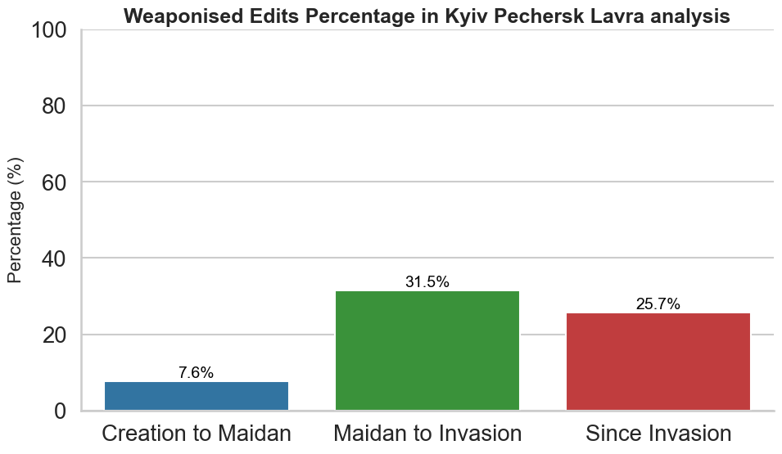
Raw Results (unvalidated)
10/13

Slide 11
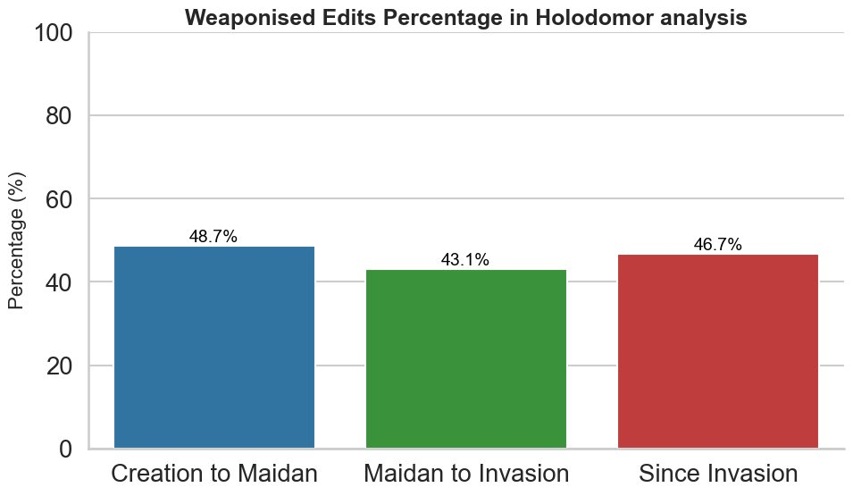
11/13

Slide 12
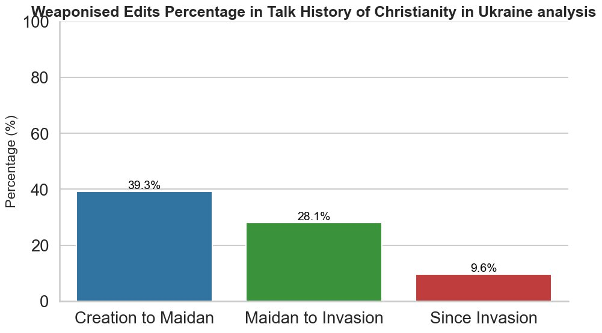
12/13

Slide 13
Next Steps
Expand Data Collection:
Incorporate additional Wikipedia pages, Talk pages, and external sources to enrich the dataset.
Increase the diversity and volume of edits for more robust analysis.
Manual Annotation:
Employ three annotators to manually label edits for fine-grained classification.
Develop Fine-Grained Classification:
Move beyond binary labels by defining multiple weaponisation levels or categories.
Identify nuanced indicators such as sentiment shifts, tone changes, and content omission
13/13

